Slide 1
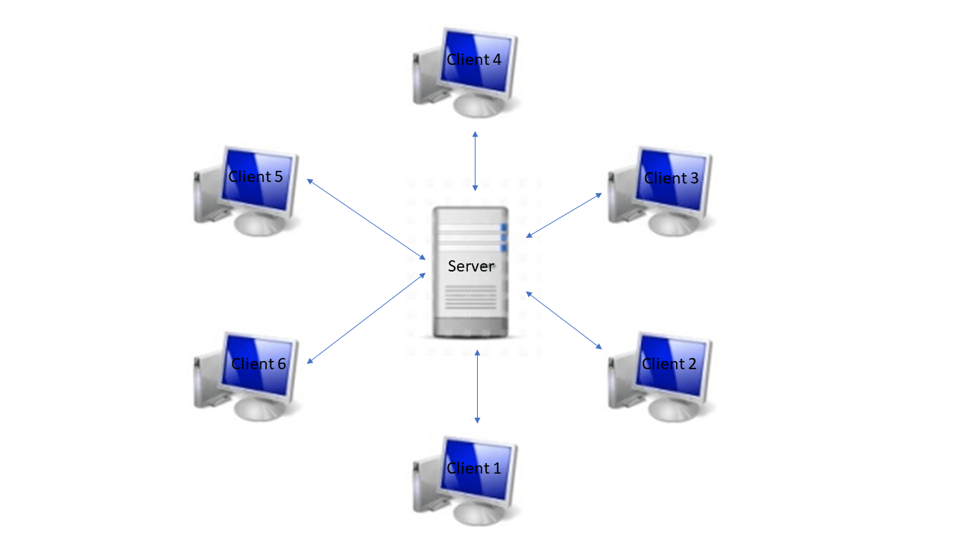
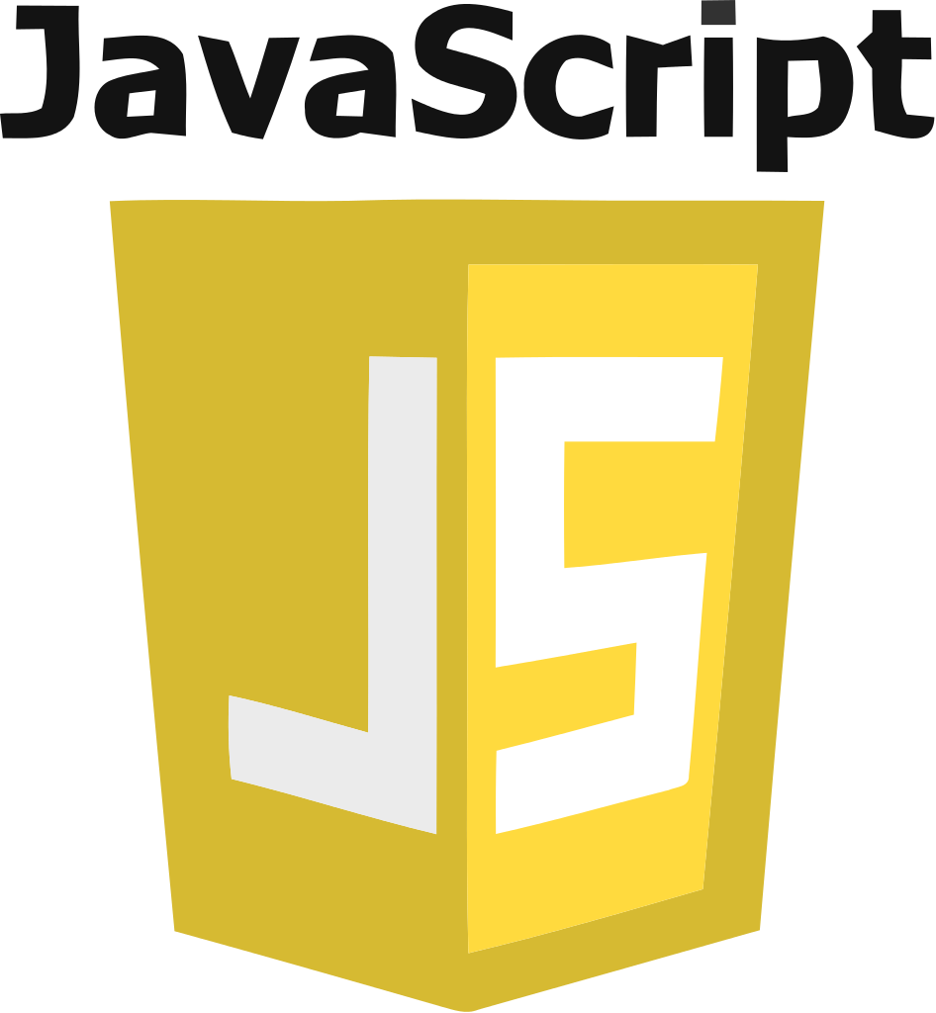
AJAX PRESENTATION
By Nishant Gupta
This Photo by Unknown Author is licensed under CC BY-SA
This Photo by Unknown Author is licensed under CC BY-SA

Slide 2
What is AJAX?
AJAX stands for asynchronous JavaScript and XML.
AJAX is not a programming language, Rather, it’s a set of existing technologies.
AJAX helps in fetching data asynchronously without interfering with the existing page.
No page reload/refresh.
Modern websites use JSON (JavaScript Object Notation) instead of XML for data transfer.

Slide 3
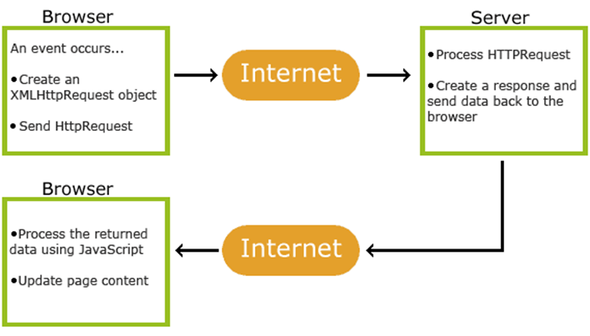
Why use AJAX?
No page reload/refresh.
Better user experience.
Saves network bandwidth.
Very interactive.

Slide 4
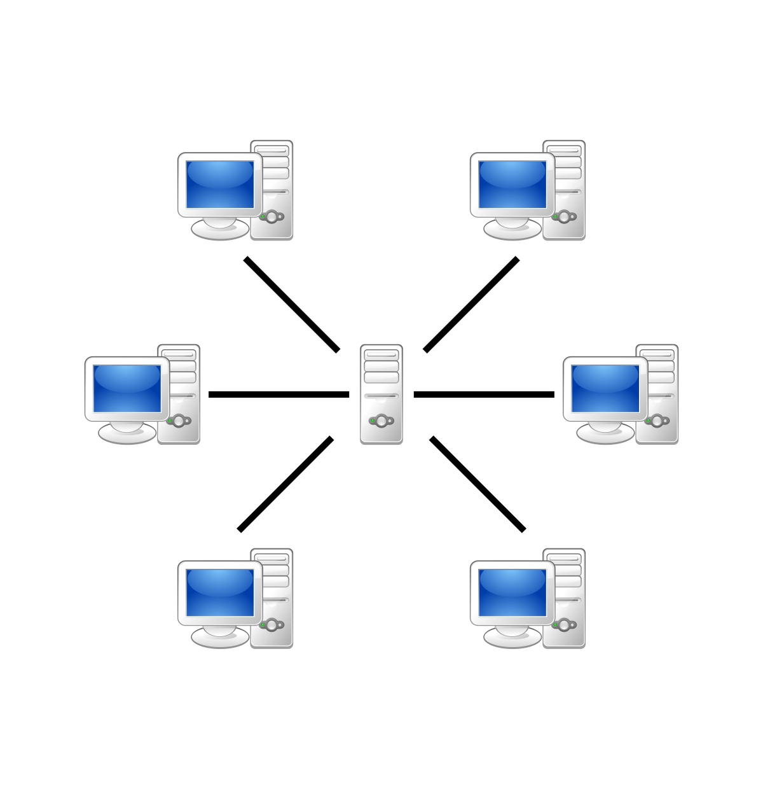
How AJAX works?
AJAX uses XMLHttpRequest object (also called xhr object to achieve this.
Modern Websites uses JSON instead of XML for Data Transfer.
Data can be transferred in any format and protocol (Not always https necessarily)
This Photo by Unknown Author is licensed under CC BY-SA

Slide 5
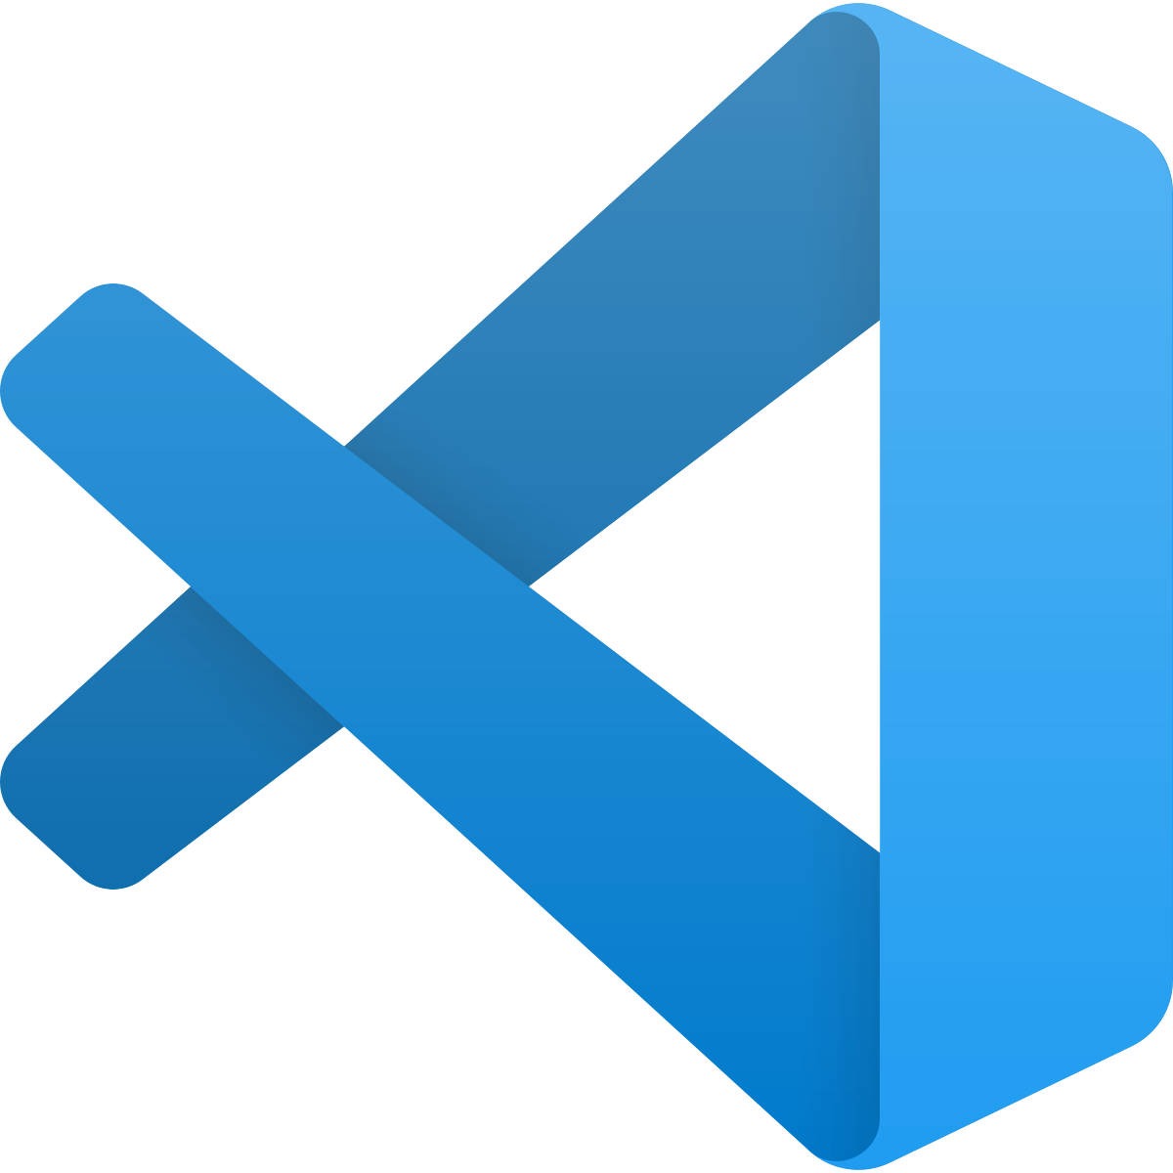
Lets Code!
Let’s go to our IDE and write some code.
We will see how AJAX and XMLHttpsRequest object works in action!
This Photo by Unknown Author is licensed under CC BY-SA

